Slide 1
Advance Internship@Clevered AI App/ Project Name
App User Manual
Author: Srishti Giri

Slide 2
Table of Contents
Acknowledgments
About me
About my Clevered journey
About desktop assistant
How to use the App
Toolkit walkthrough
Contact details

Slide 3
Acknowledgements
I would like to express my heartfelt gratitude to the Clevered Team,Mr ken,Group members and Mani Ma'am for their unwavering support throughout this project and internship. Your guidance, expertise, and encouragement have been invaluable, enabling me to grow and succeed. Thank you for this incredible opportunity and for believing in me.

Slide 4
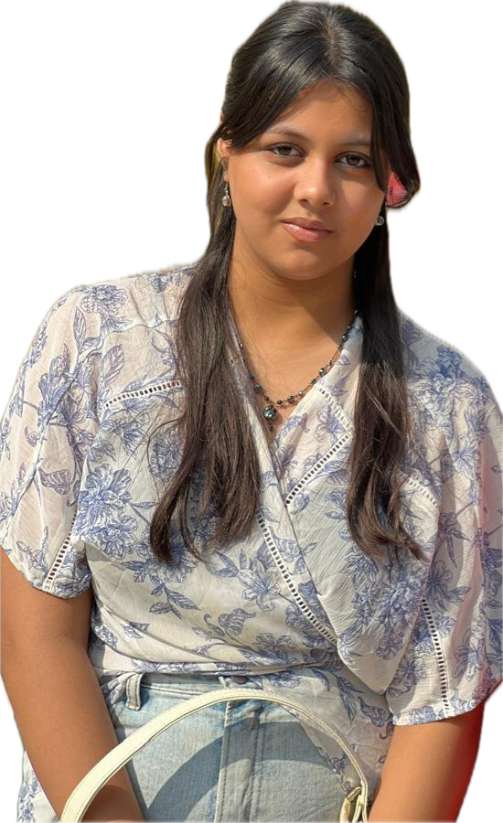
About Me..
Greetings! I am Srishti Giri, a dedicated high school student of 12th grade studying in noida, India with an unwavering passion for artificial intelligence. My insatiable curiosity drives me to continually seek out new learning opportunities and challenges. I am committed to expanding my expertise and contributing to the transformative world of AI, always striving for excellence and innovation.

Slide 5
About My Internship with Clevered..
My experience with the Clevered internship has been incredibly enriching and transformative. Working alongside a talented team, I had the opportunity to dive deep into real-world projects, enhancing my skills and knowledge in AI and software development. The supportive environment and expert mentorship fostered my growth, making this internship an invaluable step in my career journey.

Slide 6
About App..
Introducing our advanced Desktop Assistant, designed to streamline your digital experience. With intuitive start and close options, this powerful tool offers seamless interaction through a conversation button, allowing you to give commands and receive precise outputs. Additionally, it features sophisticated speech recognition capabilities, making it easier than ever to manage tasks hands-free. Experience the future of productivity with our cutting-edge Desktop Assistant.

Slide 7
How do I use the App?
To utilize the Desktop Assistant project, begin by ensuring all requisite libraries are imported. This includes pyttsx3, pyaudio, trinket, and speech_recognition. Follow these steps to establish and run the project in Python 3.11.9:
Library installation
2. Launch Idle
3. Create a Graphical User Interface (GUI)

Slide 8
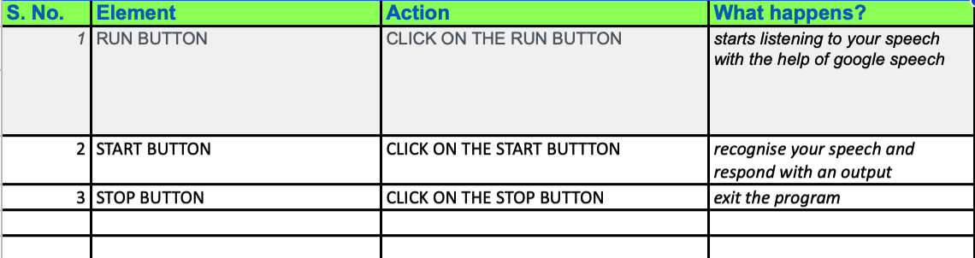
Option Name
(This will be repeated for each option of the App)
REQUIREMENTS
1. Stable internet is required
2. Mic of the computer should work properly
3. Project is made in IDLE so the computer should have IDLE platform

Slide 9
Contact Person
Email id - srishtigiri2302@gmail.com

Slide 10
Thank you!

